Slide 1

A Project Review Meeting on Prescription Management System
By
Name : G.S.S Gyanadeep roll : 2520080008
Name Garikapati Mahidhar roll : 2520090138
Team Number: 34
Under the guidance of
Dr. Niramala Jyothi
Associate Professor
Department of Computer Science and Engineering
Koneru Lakshmaiah Education Foundation (Deemed to be University estd. u/s. 3 of the UGC Act, 1956) Off-Campus: Bachupally-Gandimaisamma Road, Bowrampet, Hyderabad, Telangana - 500 043. Phone No: 7013824981, www.klh.edu.in

Slide 2
Abstract
The Prescription Management System offers a range of benefits to healthcare stakeholders. Doctors can easily generate digital prescriptions, reducing the risk of illegible handwriting and prescription errors. Patients can access their complete medication history, empowering them to better manage their healthcare. Pharmacies can efficiently receive and process prescriptions, streamlining the dispensing process and minimizing delays. The system's secure data storage and access controls ensure the confidentiality and integrity of patient information. By automating the prescription lifecycle, the Prescription Management System enhances efficiency, improves patient outcomes, and supports the broader transition towards a digitalized healthcare ecosystem.

Slide 3
Introduction
Healthcare systems worldwide are rapidly adopting digital technologies to improve the quality, accuracy, and accessibility of medical services. One of the most important aspects of healthcare is prescription management, which involves creating, storing, updating, and accessing patient prescriptions. Traditional paper-based prescription systems are often associated with challenges such as illegible handwriting, medication errors, loss of records, prescription fraud, and inefficient communication between healthcare providers and pharmacies.

Slide 4
The Prescription Management System is a web-based application developed to address these challenges by providing a secure and efficient platform for managing prescriptions electronically. The system enables doctors to generate digital prescriptions, patients to access their medication records, and pharmacies to receive and process prescriptions in a streamlined manner. By digitizing the prescription lifecycle, the system improves accuracy, enhances patient safety, and reduces administrative workload.

Slide 5
Problem Statement
Apollo Hospital in Visakhapatnam serves thousands of patients every day across various medical specialties. Managing a large volume of prescriptions manually can lead to medication errors caused by illegible handwriting, incorrect dosage interpretation, and delays in communication between doctors and pharmacies. Additionally, tracking patient medication adherence and maintaining prescription records efficiently can be challenging. These issues may affect patient safety, treatment effectiveness, and overall healthcare efficiency. Therefore, there is a need for a secure and centralized Prescription Management System that digitizes prescription handling, improves coordination among doctors, patients, and pharmacies, reduces medication errors, and enhances the quality of healthcare services.

Slide 6
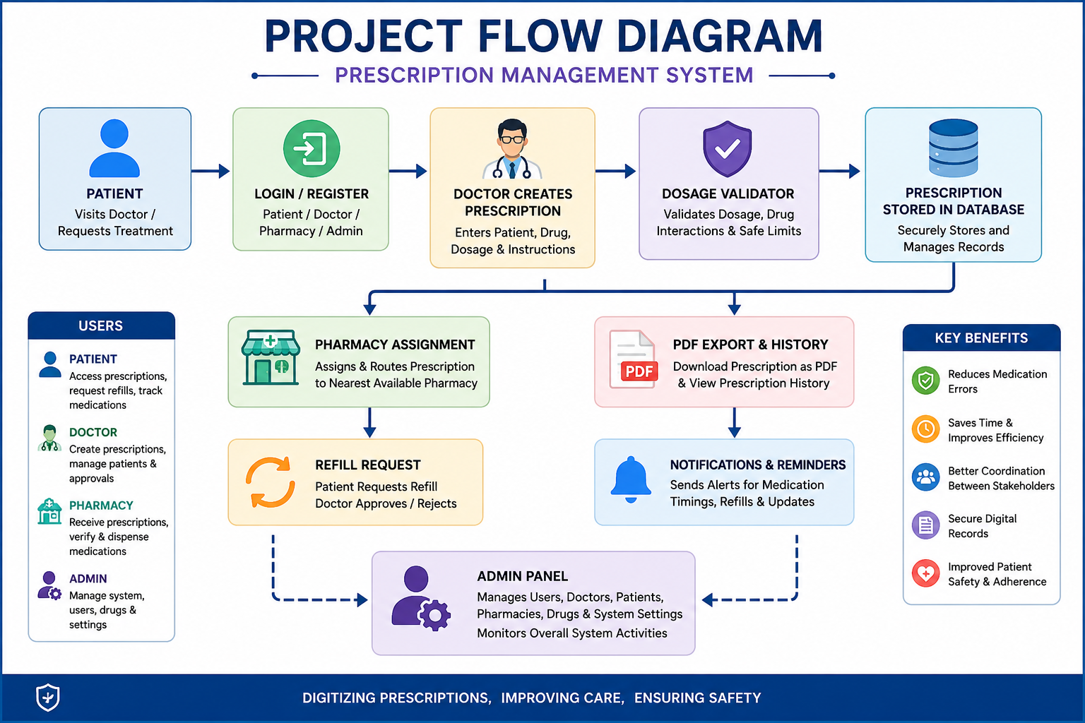
Project Flow Diagram

Slide 7
Objectives with Justification
Objective 1: To Digitize Prescription Management
Justification: Traditional paper-based prescriptions are difficult to store, retrieve, and manage. Digitizing prescriptions improves accessibility, reduces paperwork, and ensures efficient record management.
Objective 2: To Reduce Medication Errors
Justification: Digital prescriptions and dosage validation help prevent errors caused by illegible handwriting, incorrect dosage instructions, and manual data entry mistakes

Slide 8
Objective 3: To Maintain Centralized Prescription Records
Justification: A centralized database allows healthcare providers and patients to access prescription history quickly, improving treatment continuity and decision-making.
Objective 4: To Improve Communication Between Doctors, Patients, and Pharmacies
Justification: The system enables seamless sharing of prescription information, reducing delays and misunderstandings in medication management.

Slide 9

Your title here
01
Objective 3: To Maintain Centralized Prescription Records
Presentations are communication tools that can be used as demonstrations, lectures, speeches, reports, and more.
02
Title
Justification: A centralized database allows healthcare providers and patients to access prescription history quickly, improving treatment continuity and decision-making.
03
Title
Objective 4: To Improve Communication Between Doctors, Patients, and Pharmacies
04
Title
Justification: The system enables seamless sharing of prescription information, reducing delays and misunderstandings in medication management.

Slide 10
Expected Outcomes of the Proposed Work
Expected Outcomes
Digital Prescription Management
The system enables doctors to create, store, and manage prescriptions electronically, reducing dependency on paper-based records.
Reduced Medication Errors
Dosage validation and digital prescription generation help minimize prescription mistakes and improve patient safety.
Improved Prescription Accessibility
Patients, doctors, and authorized pharmacies can access prescription information quickly and securely.
Efficient Refill Management
Patients can submit refill requests online, reducing manual processes and improving convenience.
Enhanced Pharmacy Coordination
Prescriptions can be assigned and shared with pharmacies efficiently, improving medication delivery and service quality.

Slide 11
Expected Outcomes of the Proposed Work
Title
Title
Title
Title
Title
Expected Outcomes
Digital Prescription Management
The system enables doctors to create, store, and manage prescriptions electronically, reducing dependency on paper-based records.
Reduced Medication Errors
Dosage validation and digital prescription generation help minimize prescription mistakes and improve patient safety.

Slide 12
Conclusion and Future Scope
Conclusion
The Prescription Management System successfully provides a digital platform for managing prescriptions in a secure, efficient, and user-friendly manner. The system enables doctors to create electronic prescriptions, patients to access their medication records, and pharmacies to process prescriptions effectively. Features such as drug search, dosage validation, refill requests, prescription history, notifications, and adherence tracking help improve patient safety and reduce medication errors. By automating prescription-related processes, the system minimizes paperwork, enhances communication among healthcare stakeholders, and improves the overall quality of healthcare services.

Slide 13
References
Some information from Chat Gpt
.Used Languages are
HTML
CSS
Java Script
SQL
Boot Strap

Slide 14
Future Scope:
The Prescription Management System can be further enhanced by integrating advanced technologies such as Artificial Intelligence, Cloud Computing, Mobile Applications, and Telemedicine services, transforming it into a comprehensive digital healthcare solution that supports smarter, safer, and more accessible healthcare delivery.

Slide 15
CO Mappings
CO 1 : Apply HTML5, CSS3, and JavaScript fundamentals to design responsive web pages. (Used in homepage, forms, styling, navigation.)
CO 2 : Develop reusable React components and implement component-based architecture. (Used in Navbar, Dashboard, Login, Prescription Form components.)

Slide 16
CO 3 : Implement state management, event handling, and form validation in React applications. (Used in patient forms, prescription forms, login validation.)
CO 4 : Design and develop dynamic single-page applications using React.js and modern frontend frameworks. (Apollo Hospital Portal developed as a React SPA.)

Slide 17
CO 5 : Integrate frontend applications with backend services and manage data effectively. (Patient records, prescriptions, doctor information, database connectivity.)
CO 6 : Deploy, test, debug, and maintain web applications using modern development tools. (VS Code, npm, Vite, GitHub, localhost testing, debugging.)

Slide 18
Thank you

